Slide 1
Technology Hackathon 2025
Gen AI-Based Data Profiling
Team Peniel
March 2025
Srivastava, Aryan
Banerjee, Oishwarjya
Goel, Rushil
Mittal, Vani
Gokanakonda, Ravi Kumar

Slide 2
Our Solution and Data Exploration and Creation
Solution: We have proposed complete solution which involves
Interactive chatbot: Enables data and rule uploads, fetches real-time internet data, and assists with regulatory compliance queries.
LLM (Large Language Model): Extracts and interprets regulatory reporting rules, also pre-processes data based on mentioned rules and input values
Hybrid ML: Analyses data, adaptively assigns a risk score and risk severity based on rules, current market trends, and weightages of different attributes that contribute towards risk.
ML and LLM also suggest remediation techniques based on type of risk imposed or type of rule failed.
Additional Features
Categorization of transactions based on risk types:
Regulatory risk defaulters
Potential defaulters
Compliant data
Errors in uploaded data
Assigning a risk severity based on adaptive risk score: high, medium, low
Visualizing trends in data using diverse graphs, charts, and tables
Data Exploration and Creation
Thoroughly examined and consolidated the Federal Reserve's regulatory reporting guidelines to extract key rules, define data validation scenarios, and identify relevant attributes. This process ensured that our data aligns with compliance standards and supports accurate reporting.
Attribute creation and refining for our data using current market trends, incorporating real-time insights, industry patterns, and emerging developments to improve relevance and accuracy
Performed data cleaning and pre-processing by prioritizing fields based on their weighted importance, as determined from regulatory guidelines to align with compliance requirements. By doing so, we focused on high-impact attributes, improving data integrity and compliance alignment for precise reporting.
Generated and populated data by applying calculation models derived from the Federal Reserve’s information banks, financial institution records, and comprehensive market analysis. By leveraging these trusted sources, we ensured that the synthesized data reflected real-world financial conditions, aligning with regulatory expectations and supporting informed decision-making.
Created diverse sample data sets to encompass a wide range of scenarios relevant to risk assessment. This included generating cases for our risk score calculations, ensuring that different risk factors were accurately represented. Also created data to cover our categorizations of risk based on type and severity.

Slide 3
Key Technology Decisions
Python
Faster and reliable
Simplified Syntax
Good Machine Learning Supports
Libraries used: FastAPI, NumPy, OpenAI, Pandas
ChatGPT 4o-Mini
Faster and more efficient
Improved context understanding
Lightweight but powerful
ML Model
Random Forest Regression: Handles Non-Linearity and High-Dimensional Data
K-Means Clustering: Scalable and Efficient
Libraries used: Pickle, MatPlotLib, Seaborn, SKLearn
ReactJS
Reusable Components
Virtual DOM for performance
Rich ecosystem
Libraries used: ChartJS, AntD, Axios

Slide 4
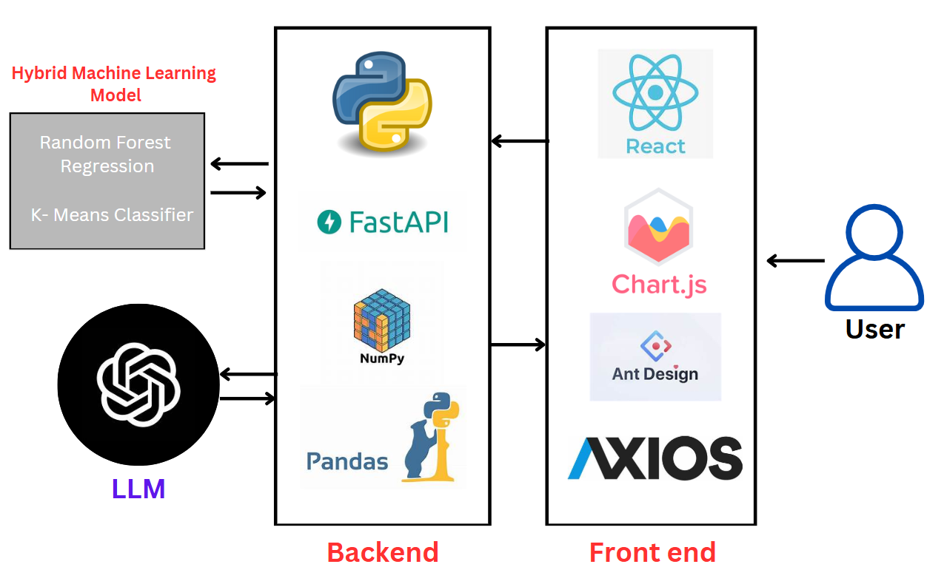
Architecture Diagram

Slide 5
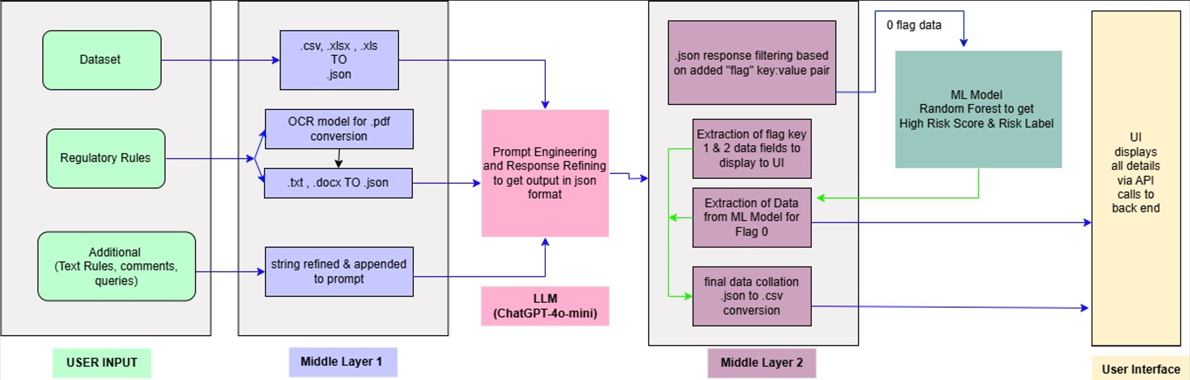
Flow Diagram

Slide 6
Challenges Faced, Our Resolution, and Future Scope
Our project was limited to using only freely available tools, which posed a significant challenge due to the restrictive data processing capabilities of these tools.
Most free-tier AI and data modeling platforms impose strict limitations on the amount of data they can handle at once, particularly in terms of token limits for large language models (LLMs) and memory constraints for machine learning frameworks.
Within this, we had to strategically optimize our approach by refining prompts to minimize token usage, and leveraging efficient pre-processing techniques to maximize the utility of available resources.
Due to the extensive nature of the Federal Reserve's regulatory reporting guidelines and time constraints, we focused our solution on the Retail sector. However, our approach is designed to be scalable and adaptable to other reporting schedules as well.
Due to the limitations discussed, we were not able to integrate into our model some features that we had initially thought of implementing.
The consideration and weightage given to geo-political conditions across different areas of service, as well as the history of the customers with the bank, play an important role in deciding what level of risk their transactions may impose and the steps that can be taken to remediate them.
Another point of distinction that we had brainstormed during this project was the ability of Wells Fargo to have its own LLM, safe to access some non-essential information about the bank, and be able to assist us in detecting anomalies, potential fraudulent data across various businesses.
Given the scope that we were able to integrate, we could not work on these. However, our approach makes us believe that the implementations may not be too far in the future.

Slide 7
UI Walkthrough Demo

